Slide 1
Chapter 4
Process Models
Slide Set to accompany Software Engineering: A Practitioner’s Approach, 8/e
by Roger S. Pressman and Bruce R. Maxim
Slides copyright © 1996, 2001, 2005, 2009, 2014 by Roger S. Pressman
For non-profit educational use only
May be reproduced ONLY for student use at the university level when used in conjunction with Software Engineering: A Practitioner's Approach, 8/e. Any other reproduction or use is prohibited without the express written permission of the author.
All copyright information MUST appear if these slides are posted on a website for student use.

Slide 2
Contents
A Generic(通用）Process Model
Process Flow
Summary
Further discussion

Slide 3
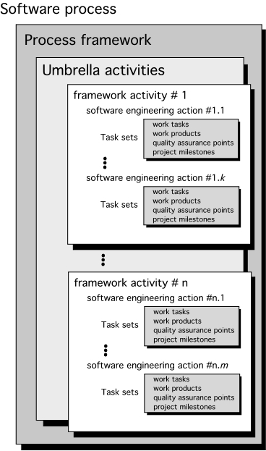
A Generic Process Model
P34 for concepts

Slide 4
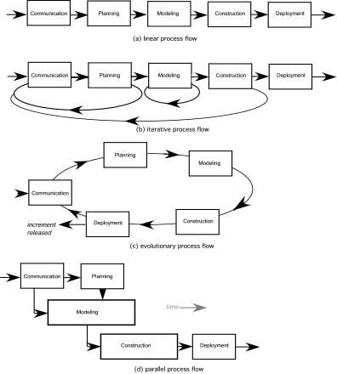
Process Flow

Slide 5
Identifying a Task Set
A task set defines the actual work to be done to accomplish the objectives of a software engineering action.
A list of the task to be accomplished
A list of the work products to be produced
A list of the quality assurance filters to be applied

Slide 6
Prescriptive Models
Prescriptive process models advocate an orderly approach to software engineering
That leads to a few questions …
If prescriptive process models strive for structure and order, are they inappropriate for a software world that thrives on change?
Yet, if we reject traditional process models (and the order they imply) and replace them with something less structured, do we make it impossible to achieve coordination and coherence in software work?

Slide 7
The Waterfall Model

Slide 8
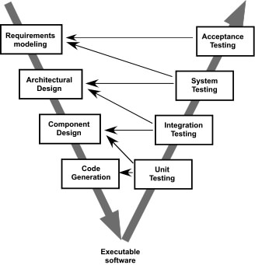
The V-Model

Slide 9
The Incremental Model

Slide 10
Evolutionary Models: Prototyping
Quick
plan
communication
Modeling
Quick design
Deployment
delivery &
feedback
Construction
of prototype
Construction
of prototype

Slide 11
Evolutionary Models: The Spiral

Slide 12
Still Other Process Models
Component based development—the process to apply when reuse is a development objective
Formal methods—emphasizes the mathematical specification of requirements
AOSD—provides a process and methodological approach for defining, specifying, designing, and constructing aspects
Unified Process—a “use-case driven, architecture-centric, iterative and incremental” software process closely aligned with the Unified Modeling Language (UML)

Slide 13
The Unified Process (UP)
elaboration
inception

Slide 14
UP Phases

Slide 15
UP Work Products

Slide 16
Personal Software Process (PSP)
Planning. This activity isolates requirements and develops both size and resource estimates. In addition, a defect estimate (the number of defects projected for the work) is made. All metrics are recorded on worksheets or templates. Finally, development tasks are identified and a project schedule is created.
High-level design. An external specification is created for each component and a component design is created. Prototypes are built when uncertainty exists. All issues are recorded and tracked.
High-level design review. Formal verification methods (Chapter 21) are applied to uncover errors in the design. Metrics are maintained for all important tasks and work results.
Development. The component level design is refined and reviewed. Code is generated, reviewed, compiled, and tested. Metrics are maintained for all important tasks and work results.
Postmortem. Using measures and metrics collected the effectiveness of the process is determined. If this is a large amount of data it should be analyzed statistically), Measures and metrics should provide guidance for modifying the process to improve its effectiveness.

Slide 17
Team Software Process (TSP)
Build self-directed teams that plan and track their work, establish goals, and own their processes and plans. These can be pure software teams or integrated product teams (IPT) of three to about 20 engineers.
Show managers how to coach and motivate their teams and how to help them sustain peak performance.
Accelerate software process improvement by making CMM Level 5 behavior normal and expected.
The Capability Maturity Model (CMM), a measure of the effectiveness of a software process, is discussed in Chapter 30.
Provide improvement guidance to high-maturity organizations.
Facilitate university teaching of industrial-grade team skills.

Slide 18
Summary(p38)
What is a generic process model?

Slide 19
futher disscution
Problem and points to ponder
P39. 3.4

